Slide 1

A Presentation on
Student attendance management system
By:
Mr. Ritesh Pratap Shinde (Roll No. 161,S Y CSE-’A’)
Mr. Vallbh Parashram shinde(Roll No. 163, SY CSE-’A’)
Mr. Arun Dattatray Tipugade(Roll No. 165, SY CSE-’A’)
Mr. Omkar Tanaji Tipugade(Roll No. 166, SY CSE-’A’)
Dr. D.Y. Patil Pratishthan’s College of Engineering , Kolhapur

Slide 2
contents
Introduction
Problem Statement
System Architecture
Objectives
System Requirement
Conclusion
References

Slide 3
Introduction
Student attendance management is an important aspect of educational institutions. Accurate and timely recording of attendance is crucial for monitoring student performance and ensuring that students are meeting the requirements of their courses. To facilitate this process, a student attendance management system can be implemented, which can automate the attendance recording process and provide real-time attendance reports for teachers and administrators.
The goal of this mini-project is to develop a student attendance management system that can efficiently manage student attendance data. The system will allow teachers to take attendance for their classes and store the data in a database. The attendance records will be accessible to authorized personnel, including teachers, school administrators, and parents. The system will also generate reports on attendance data for each student, which can be used to track their attendance and monitor their progress throughout the academic year.

Slide 4
Problem Statement
Here, the main part of this program is a path.
For that you have to either create a path or change the path
By using a traditional method of taking attendance we face many challenges like manually taking attendance keeping track of every day attendance.
Keeping register for attendance etc. to tackle this problem we have created a project of Student attendance management System

Slide 5
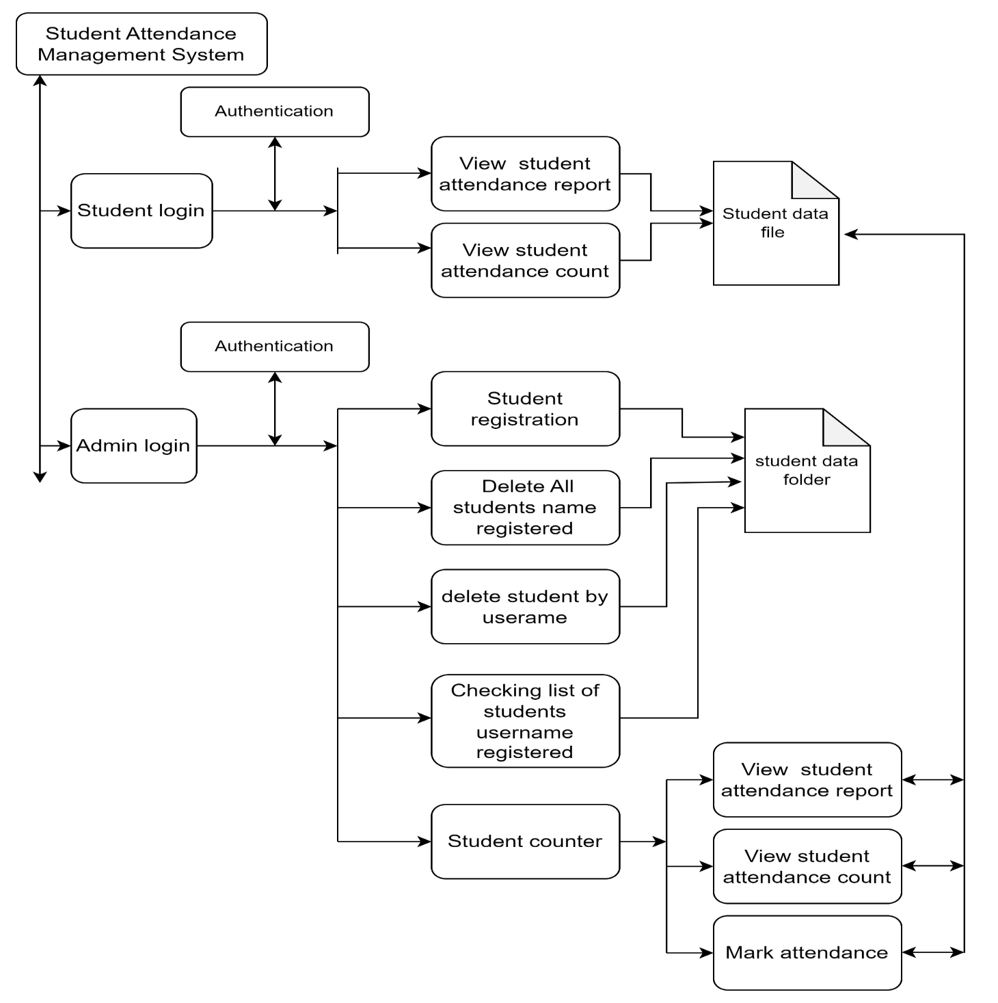
System Architecture

Slide 6
Objectives
To reduce the time that is consumed when attendance is taken manually
Easy to manage attendance of students
To calculate attendance easily
Create each and every student attendance report properly
Record all student attendance properly

Slide 7
System Requirement
Hardware & software requirements:-
Windows-10
Intel core i3 Processer
256 GB-SSD
4GB RAM

Slide 8
Conclusion
In the conclusion we have successfully implemented and developed student Attendance management System in C.
Throughout the process we aimed to automate the process of recording and managing student attendance
In development process we have achieve several objectives
1. User Interface:
In this project we include user friendly interface that allow faculties to easily navigate and interact with system. From login to taking attendance of student.
2. Attendance tracking:
In the system the faculty have to do the login then open the student ID and then click the mark the attendance after that enter the date and fill the attendance.
3.Data Management:
The data management of the system is quite simple, when we create the data of faculty or student that going to we stored in the “studentname.csv” .and you can access date wise attendance of the student.
Overall, the student attendance management project in cpp provides an efficient, reliable, and user-friendly solution for managing student attendance in educational institutions.

Slide 9
References
1)“Managing Student Attendance: successful strategies for Reducing Truancy” by
Ken Reid
2) “Attendance Management: A comprehensive Guide to Designing, Implementing,
And Evaluating programs to Improve school Attendance” by Michael A. Gottfriend
3)WWW.google.com

